Slide 2
In some places where there are many pedestrians, people set up “little free libraries.”They are little boxes with books you can read and return. If you have a book you want to donate, you can leave them there for other people. They are usually filled with easy, light reading.

Slide 3
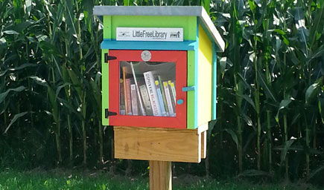
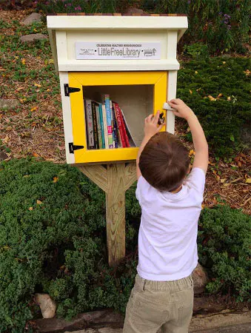
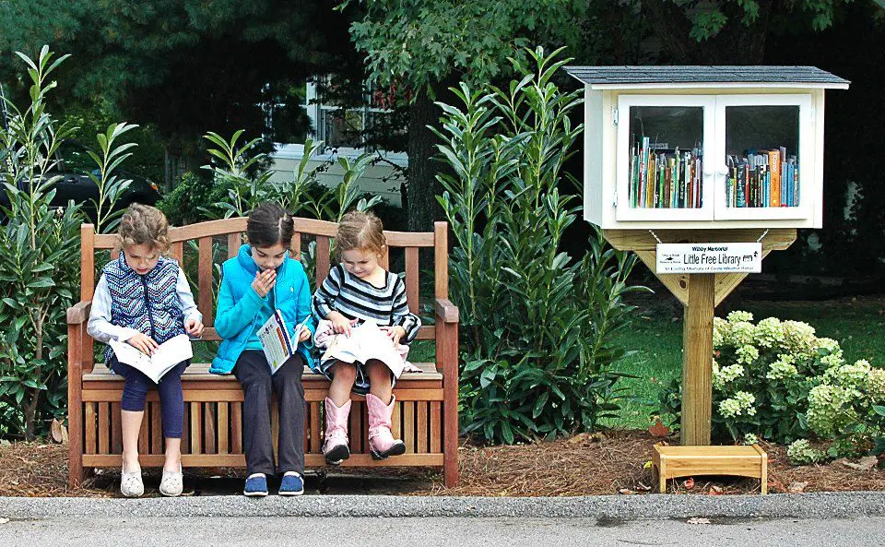

Slide 4
Little Free Library 的由来：这个概念来自于一个平凡人的简单善念，第一个袖珍图书馆是由美国威斯康辛州(Wisconsin)一名叫Todd Bol的男子在2009年建立的，他的母亲曾经是一位爱阅读的小学老师。为了纪念她，这名男子在自己家院子里盖了个像学校屋舍的小木屋，里面放置了自己喜欢的图书，免费供大家阅读。后来，此举为大多数人喜爱，再后来 Little Free Library 就成了一个公益机构，而建立 Little Free Library 的行为迅速蔓延至世界各地。

Slide 5
Little Free Library is a national movement aimed at promoting literacy within communities. Each of our little free libraries starts out filled with books provided by the Bedford Public Library that are free to take and to keep for as long as you please. These little free libraries run on book donations. Feel free to donate your used books to a little free library in the community and to return the books you borrowed when you are done.
Locations include:
Thornton Park
Head Start
Springville Grocery
Johnny Junxions
Milwaukee Trail
Hillcrest Christian Church
Dollar General in Oolitic
LARC
Avoca Baptist Church

Slide 6
Dear James,
With the approach of the English Speech Contest tomorrow, I'm writing to bring forward some of the necessary things to notice in case of any trouble it may accur.
Our English Speech Contest will start as scheduled in the school hall at 8 a. m. tomorrow morning. All the participants will firstly present their meticulously prepared speech, followed by a question-and-answer session. A score and comment of their performance afterwards are much needed and greatly anticipated. By the way, our shuttle bus will be ready half an hour earlier outside of your apartment to pick you up.
An earnest welcome to your arrival!
Yours,
Li Hua

Slide 7
I'm amazed (amaze) how wildly passionate (passion) people are in their feelings toward this novel --regardless of whether they love or hate “The Alchemist”.
After listening to “the sign”, the boy is off for the adventure in his personal jouney of exploration (explore) and self-discovery, searching for the hidden (hide) treasure located (locate) near the pyramids in Egypt.
The treasure lies where your heart belongs.
Like many writers, I'm an expert at procrastination. When I ought to be working on an assignment, with the clock ticking towards my deadline, I'll sit there watching pointless (point) videos on YouTube.
This fresh perspective on procrastination is beginning to open up exciting new approach to reducing (reduce) the habit.
Hundred more deaths could have happened (happen) in Washington state over the past weeks of bad air from the fires.

Slide 8
In these pictures, you can usually see the phone the person is taking a picture with. Selfies taken using a mirror often are taken in a bathroom, which some people think is offensive.
轮流骑滑板车
take turns riding a scooter
在一个晴朗的星期六下午
on a crisp Saturday afternoon
一个留着胡须、一头乱蓬蓬的卷发的男人出现了
a bearded man with a head of messy curls appeared
像抱婴儿一样抱起她
cradle her like a baby
Kim的恐惧变成了啜泣，然后求助
Kim's fear became sobs, and then begged for help.
开始乱踢乱打，试图挣脱出来
She began kicking and flailing, trying to get free of the man's grip.

Slide 9
flail
1.(sth) (about/around) to move around without control; to move your arms and legs around without control 乱动；胡乱摆动
The boys flailed around on the floor. 男孩子们在地板上任意地动来动去。
He was running along, his arms flailing wildly. 他向前跑，拼命摆动双臂。
2.to hit sb/sth very hard, especially with a stick （尤指用棍棒）猛击，猛打

Slide 10
天道酬勤（勤奋与决心得到回报）
Hard work and determination pay off
把成就主要归功于......
给...颁奖
present sb. with an award
学业成就
academic accomplishment
对全球公正的努力/付出
the commitment to global justice
帮助不发达地区的贫穷孩子
help deprived children in underdeveloped countries

Slide 11
记住，努力不一定能保证成功，但没有付出，什么都不可能。
Keep in mind that effeots doesn't necessily gurantee success, but without devotion, nothing is possible.
梦想值得你付出时间和努力。
Dreams deserve your time and efforts.
钱应该用在最重要的地方。
Money should be put where it matters most.
她是第一个提出这个想法的人。
She is the first to put forward the idea.
这是爸爸在他的职业生涯中第一次得到一个暑假的机会。
It's the first time that dad has been offered a summer off in his career.

Slide 12
1. I am grateful __________ staff at Coventry University ___________ gave me support and resources I needed, especially with English not being my first language, and without that I would not ______________ (achieve) what I have.
2. Coventry University has made a big impact on _________ I am today.

Slide 13
1、 They view this kind of advertising __________ environmental damage and will take strong action against it.
2、As for the Brazilian artist’s work, the authorities __________ (annoy) but could find nothing to charge him ___________.
3、They had no other option but __________ (clean) the tunnel.
4. They find dirty surfaces and paint them with images or messages ________(use) cleaning brushes or pressure hoses.
5.他（老人）的目光一直扫过每一个人，寻找能和他一起下棋的人。
His eyes kept jumping from person to person, searching for someone to join him for a game of chess.

Slide 14
把某人置于危险的境地
put sb at risk of
弥补损失
make up for the loss of
解决一个关于...的问题
addressed a preblem concerning/address an envelop/He addressed an audience of 10.000 people.
经常参加刺激大脑的活动
regularly engage in mentally stimulating activities
社交互动
social interaction
引起同情
arouse readers’ sympathy

Slide 15
感觉你的脾气上来了
feel your temper rising
work on one thing at a time==
工作很累人，效率低下，压力很大
The task is tiring, inefficient and highly stressful

